Slide 1
Software Testing
Code-Based Data Flow Testing
Presented By
Ning Chen, Ph.D.
Professor
Department of Computer
Science
California State University,
Fullerton
© Ning Chen, 2017
*

Slide 2
Module Objectives
This module focuses on the Code-Based Data Flow Testing

Slide 3
Code-Based Data Flow Testing
Data Flow Vs. Control Flow
  As an opposite way of Control Flow Testing, we may pay attention to the data flowing through the structure of the program (instead of the flowing of the control). This type of testing methods is under the category of Code-Based Data Flow Testing (also called Structure-Based Data Flow Testing).

Slide 4
Why Data Flow
Why do we want to pay attention to flowing of data? Hunting down bugs is not an easy task. In a real-world scenario, the program under test is just too big or too complicated. Instead of viewing the given program as a whole, maybe we can apply the divide-and-conquer strategy. By following one portion or part of the input data set that flows through the program, we try to divide the whole program into several smaller sub-programs. Since each sub-program is smaller, it is intuitively easier for us to figure how to test.

Slide 5
Research Results
Past research work based on the above ideas (flow of data and divide-and-conquer) achieved the following two sub-approaches:
  Define/Use Testing (or DU testing)
  Slice-Based Testing

Slide 6
Define/Use Testing (or DU testing)
Again, we ask a logical question first. How do you follow or monitor the flow of data?
We prefer to build some intuition by observation before we touch the formal definitions and theories.

Slide 7
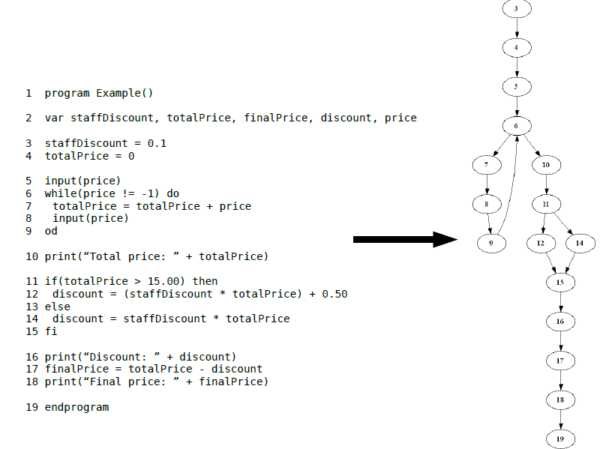
Observation

Slide 8
Pay Attention to Data
If you pay attention to the data (variable) “price” at node 5, you find that the variable price is defined there.
Node 6 shows a use of this variable (price != -1).
Node 7 shows another use of this variable (totalPrice = totalPrice + price).

Slide 9
Pay Attention to Data
At node 8, the program defines the variable price again (input (price)).

Slide 10
Summary of Observation
2 defined nodes: node 5 and node 8 (or DEF (price, 5), DEF (price,8))
2 use nodes: node 6 and node 7 (or USE (price, 6), USE (price, 7)

Slide 11
DU Pairs
For those four nodes (2 defined, 2 use), you may form four pairs (called DU pairs):
Pair (DEF (price, 5), USE (price, 6))
Pair (DEF (price, 5), USE (price, 7))
Pair (DEF (price, 8), USE (price, 6))
Pair (DEF (price, 8), USE (price, 7))

Slide 12
Why DU Pairs
A DU pair reveals the beginning and the ending of the data flow associated with a given variable.
What happens to the data flow in between the beginning and the end?

Slide 13
What Happens?
To answer that question, we need to find path(s) that links the beginning node to the ending node of a given DU pair. This kind of path is call DU path.

Slide 14
Finding DU Pairs
Now, given a variable, can we find all its DU pairs?
Yes, we just did it for the given variable price in our example.
Can we find all the DU paths for all the DU pairs?
Yes. (How?)
  You just find all the DU paths associated with a DU pair. Then, repeat the process for all other pairs.

Slide 15
Our Example
For our example, all the DU paths for the given variable price are:
<5, 6>
<5, 6, 7>
<8, 9, 6>
<8, 9, 6, 7>

Slide 16
What can you do with the DU paths?
DU paths of a given variable show you all the possible paths of that variable flowing through the program. As a tester, you may want to design test cases to traverse all the DU paths. If all things check out, you do have some confidence to claim that your program handles the given variable correctly. What happens to other variables (say, the variable totalPrice in our example)? Easy, you simply repeat the same process to find all the DU paths associated with the next variable.

Slide 17
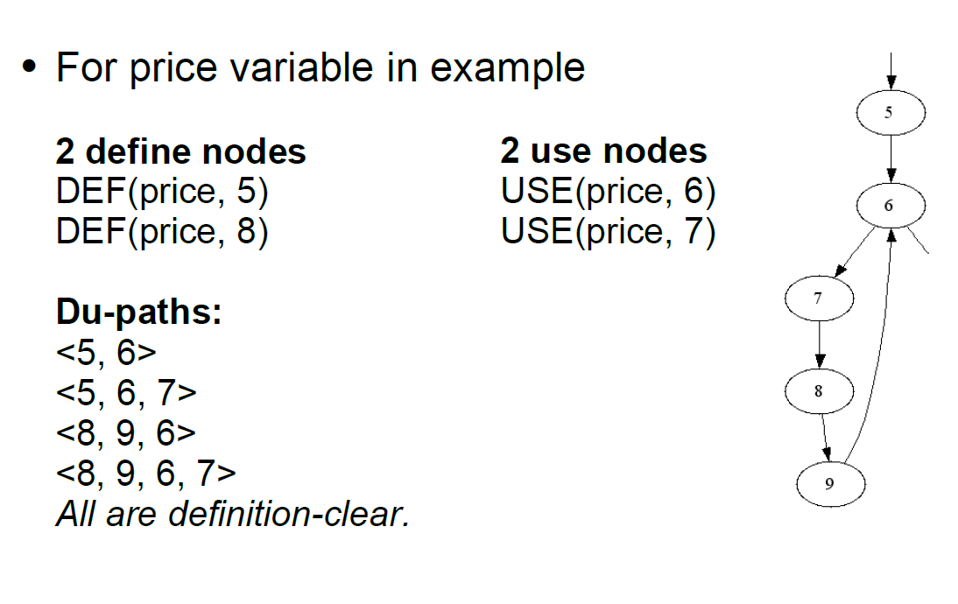
One More Time

